Slide 1

Xoxoday com: Customer Engagement through Social Media
Akhila Thakur
Madhurima Dilari
Shiva Shankar Gundla
Preethi Vudugula
Nandini Kovuru

Slide 2
Project Overview
This project analyzes:
How users interact with Xoxoday on Twitter through mentions, replies, and retweets.
Whether engagement is organic, campaign-driven, or artificially inflated.
How information flows through the network and who holds influence.
Why this matters:
Brands rely on social media for audience growth, engagement, and storytelling.
Without understanding structural engagement patterns, strategy remains guesswork.

Slide 3
Research Motivation
Business Problem:
Xoxoday posts actively on Twitter but lacks insights into:
Who engages with the brand
How influence is distributed
Whether the audience is truly interacting or only reacting to campaigns
SNA provides the structure to:
Evaluate authenticity of engagement
Detect power imbalances and bottlenecks
Reveal how conversations form and flow

Slide 4
Literature Foundation
Key concepts grounding the study:
Network Centrality (Borgatti et al., 2009):Identifies influential actors and structural positions of power.
Twitter’s Hierarchical Structure (Kwak et al., 2010):Twitter often exhibits centralized attention patterns dominated by a few accounts.
Virality Drivers (Berger & Milkman, 2012):Emotional or high-arousal content spreads more effectively.
Contest Tagging Behavior (Liu & Dai, 2020):Promotional contests may artificially inflate engagement without true interest.

Slide 5
Data Sources
The analysis uses three primary datasets:
Mentions & Replies Dataset: Directed edges capturing conversational interactions.
Retweets Dataset: Identifies how tweets are amplified across users.
Node Metadata: Profile-level attributes of accounts in the network.
Collection & Structure:
Each interaction stored as a source → target relationship.
Edge weights used for retweets.

Slide 6
Data Cleaning & Preparation
Data standardization steps (R):
Column normalization using janitor::clean_names()
Removal of redundant or empty fields
Standardization of usernames
Construction of edge lists for both networks
Ensuring no broken or orphan nodes
Result:
A fully cleaned, analysis-ready representation of Twitter interactions.

Slide 7
Methodological Framework
Social Network Analysis techniques applied:
Centrality Metrics:
Indegree: Attention received
Outdegree: Interactions initiated
Betweenness: Ability to bridge communities
PageRank: Overall influence through connectedness
Community Detection:
Louvain modularity algorithm groups accounts into natural clusters.
Temporal Analysis:
Examines daily Tweet volume for patterns or spikes.
Graph Visualization:
Force-directed layouts for structural interpretation.

Slide 8
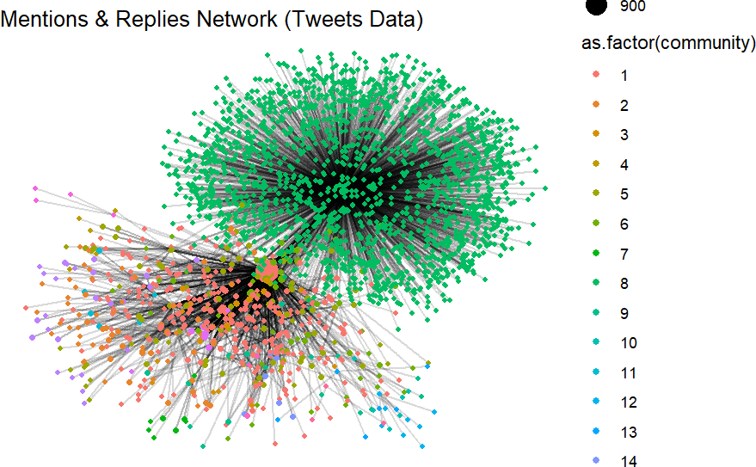
Mentions & Replies Network Structure
The network forms a hub-and-spoke structure, where @thexoxoday acts as the central hub.
Almost all user interactions are directed toward the brand rather than toward other users.
Dense cluster around the brand indicates high attention but limited community conversation.
Peripheral nodes have little connectivity to each other, showing that users do not engage horizontally.
This structure suggests brand-dominated communication rather than participatory social interaction.

Slide 9
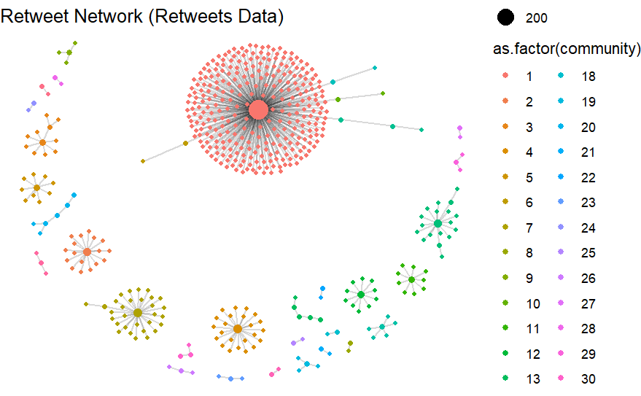
Retweet Network Structure
The graph is composed of small, disconnected star-like bursts.
Major starburst represents a single high-performing tweet that went viral.
The majority of tweets show shallow and isolated diffusion, failing to spread beyond one layer.
Retweet behavior is event-based, not continuous—engagement spikes around specific content but does not persist.
The network lacks interconnected clusters that typically signify thriving communities.

Slide 10
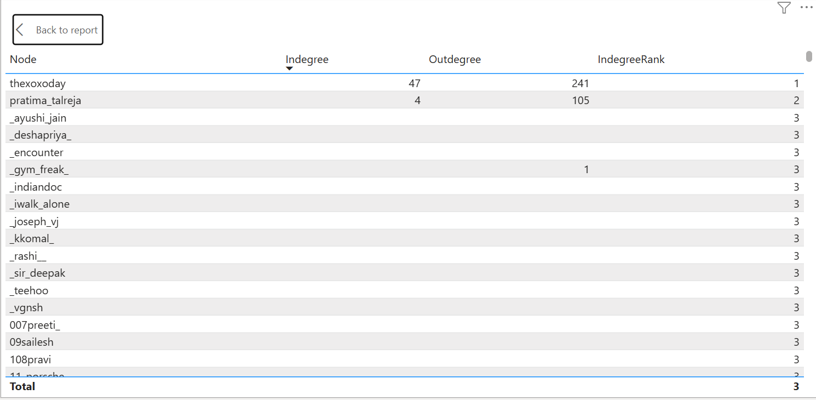
Indegree Rankings (Mentions & Replies)
@thexoxoday receives 47 incoming mentions, dominating the network.
The second-highest account receives only 4 mentions, establishing a steep inequality.
Indicates extreme centralization: the brand account attracts nearly all attention.
Highlights the absence of other influential community voices or ambassadors.
No secondary nodes emerge as potential engagement drivers.

Slide 11
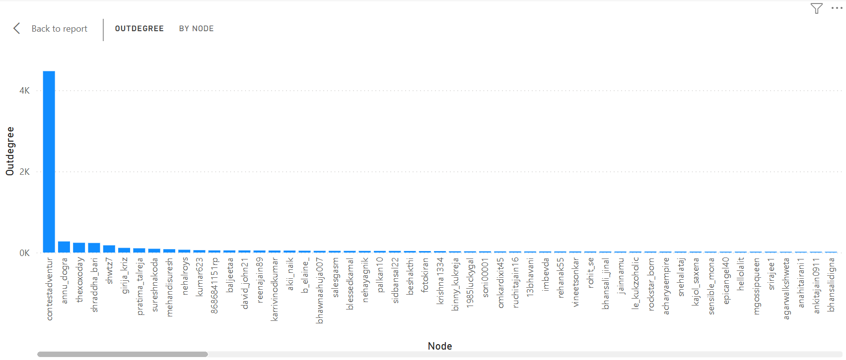
Outdegree Patterns (Who Sends Mentions?)
@contestadventur produces over 4,000 outgoing mentions—anomalously high.
Behavior suggests automated tagging or bot-driven promotional activity.
This inflates activity metrics but does not reflect genuine engagement.
@thexoxoday generates 241 outgoing mentions—active, but not disproportionate.
High outdegree distortion emphasizes the need to distinguish organic engagement from contest-driven noise.

Slide 12
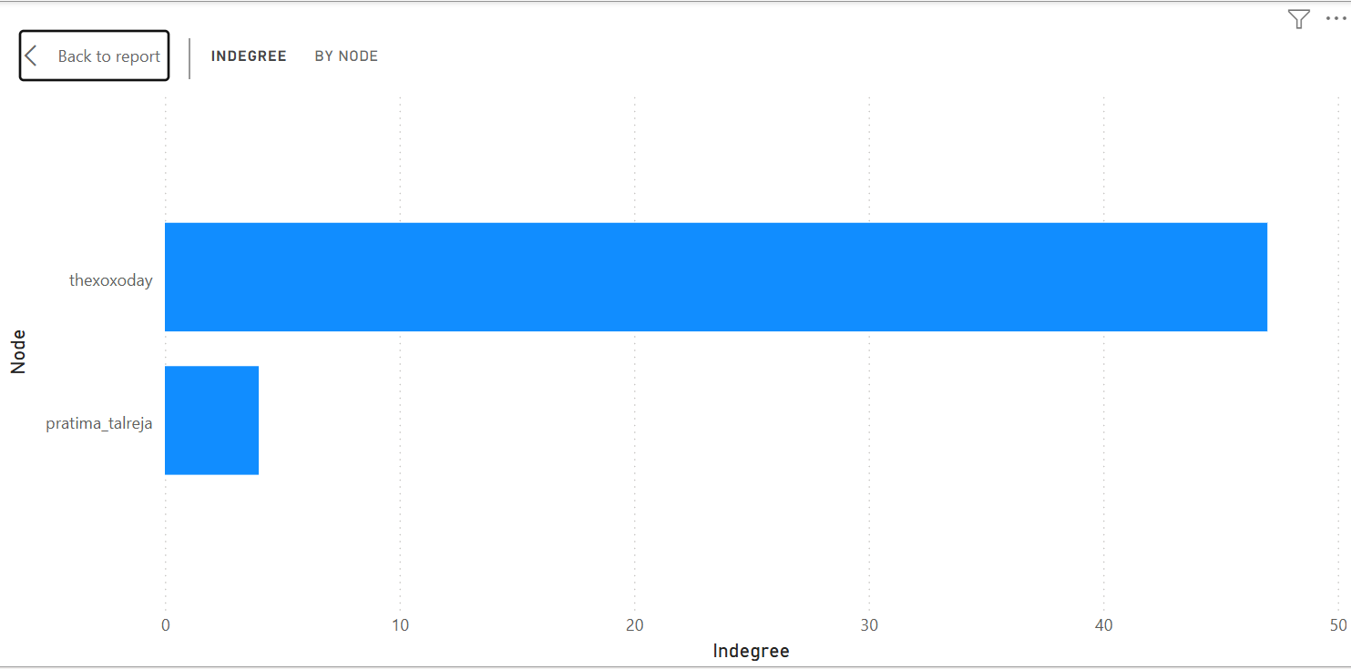
Comparison of Top Indegree Nodes
Visually demonstrates the massive gap between the top two nodes.
Confirms there is no secondary influencer or strong advocate supporting the brand’s network.
The network cannot sustain diffusion without heavy dependence on the brand account.
A healthy network usually shows multiple strong nodes—here, the imbalance is extreme.

Slide 13
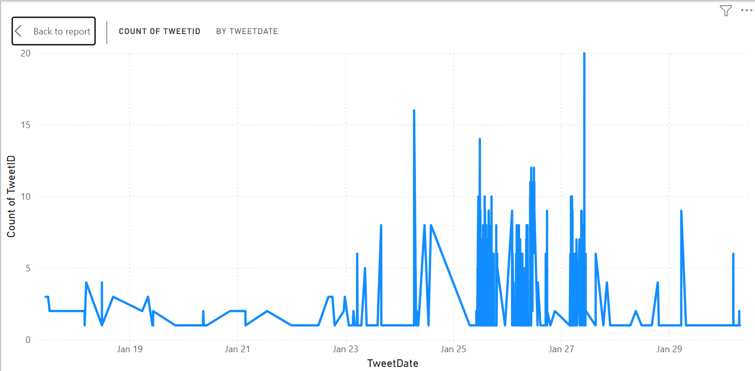
Tweet Frequency Over Time
Early activity is low and steady (1–3 tweets/day).
Sudden spike on January 26–27, likely tied to a campaign or event.
Rapid return to low activity indicates spike was not organic growth.
Suggests that sustained engagement requires more strategic content planning.

Slide 14
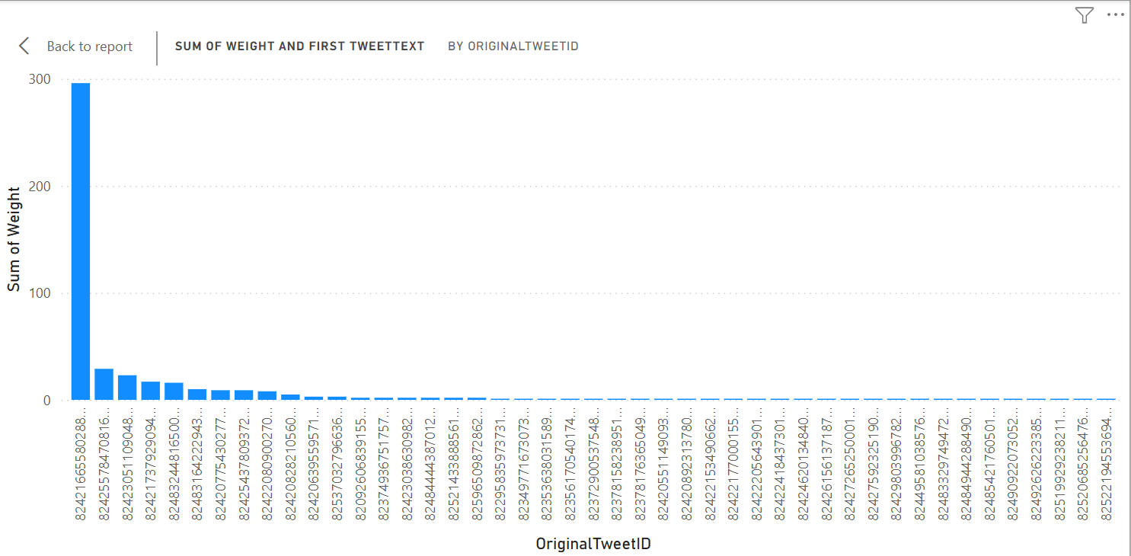
Retweet Weight Distribution
One tweet receives nearly 300 retweets, dominating diffusion.
The long tail of tweets shows little to no retweet activity.
Highly uneven distribution: viral outcomes depend on rare, exceptional content.
Indicates opportunity to analyze what made the viral tweet successful.

Slide 15
Integrated Interpretation of Findings
Synthesis of All Visuals:
Xoxoday’s Twitter engagement is highly centralized around the official brand account.
Contest-driven accounts create artificial visibility but lack community value.
Network lacks peer-to-peer engagement, reducing organic conversation potential.
Viral content exists but is not common, making it difficult to rely on for strategy.
Current network structure limits long-term audience expansion.

Slide 16
Strategic Recommendations
To strengthen Xoxoday’s engagement ecosystem:
Cultivate secondary influencers: Partner with micro-influencers or community advocates to diversify attention.
Encourage horizontal interaction: Promote discussions, polls, Q&A threads, and customer stories.
Reduce dependence on contest tagging accounts:Shift focus toward genuine user-generated content.
Develop content optimized for shareability: Emotional, visually compelling, or story-driven posts increase retweet potential.
Establish consistency around posting: Maintain a steady rhythm to avoid sporadic spikes.

Slide 17
Future Work
Expand analysis to LinkedIn or Instagram to compare cross-platform patterns.
Conduct predictive modeling to identify elements that drive virality.
Study sentiment patterns around topics that trigger the strongest engagement.
Consider longitudinal tracking to evaluate strategy changes over time.

Slide 18




Thank You

